Slide 1
Visualizing Africa's Economic and Banking Crises: Exploratory Data Analysis from 1860 to 2014
DSCI 590 - Data Visualization
Group 7 - Team members
Yashada Nikam (2001103081)
Aditya Mhaske (2001059030)
Guide: Prof. Yong-Yeol (YY) Ahn
December 8, 2023

Slide 2
Introduction
Dives deep into the economic history of 13 African countries over a century.
Dataset focuses on Banking, Debt, Financial, Inflation, and Systemic Crises.
Historical Interest: Offers insights into Africa's rich economic history.
Global Impact: Economic health influences local and global dynamics, crucial for worldwide investors (Yakubu, 2019; Yakubu & Bunyaminu, 2022).
Adds to Understanding: Identifies key events shaping Africa's economic path (Daumont, 2004; Caprio & Klingebiel, 2002; Lindgren et al., 1996).
Practical Insights: Benefits policymakers, businesses, and educators in making informed decisions (Inoue & Hamori, 2016; Jajah et al., 2022; Yakubu, 2019; Yakubu & Bunyaminu, 2022).
Data-Driven Decision-Making: Utilizes data science for meaningful pattern recognition.
Educational Value: A valuable resource for researchers, students, and those interested in African economic history.

Slide 3
Objectives and Process
To Understand following factors of African Economy
Systemic Crisis
Currency Crisis
Exchange Rates
Inflation Rates
Visualization Methods and Exploratory Data Analysis
Count Plot
Bar Plot
Donut Plot
Time Series
Map Visualizations

Slide 4
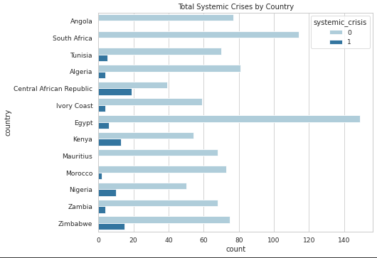
Count Plot - Systemic Crisis
The Central African Republic tops the list with the highest number of systemic crises in the presented plot.
South Africa and Egypt closely follow as the next countries with significant systemic crisis occurrences.
Kenya, Zambia, and Zimbabwe also exhibit a noteworthy frequency of systemic crises, despite being relatively smaller economies.

Slide 5
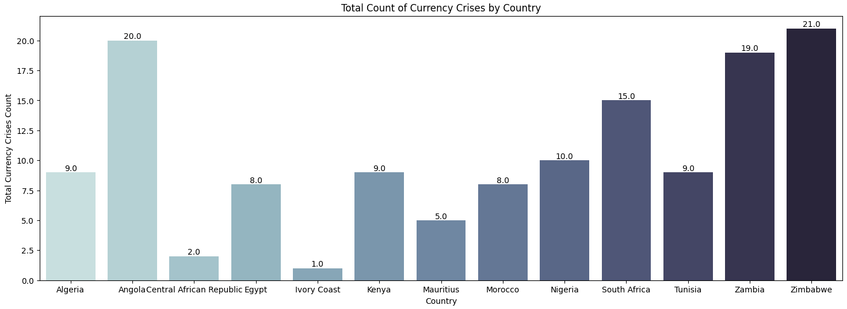
Bar Plot - Currency Crisis
Zimbabwe has experienced 21 currency crises, making it the country with the highest number in the dataset.
Angola follows closely with 20 currency crises, while Zambia and South Africa have faced 19 and 15 currency crises, respectively.
Kenya has encountered 9 currency crises, indicating a comparatively lower frequency in the dataset.

Slide 6
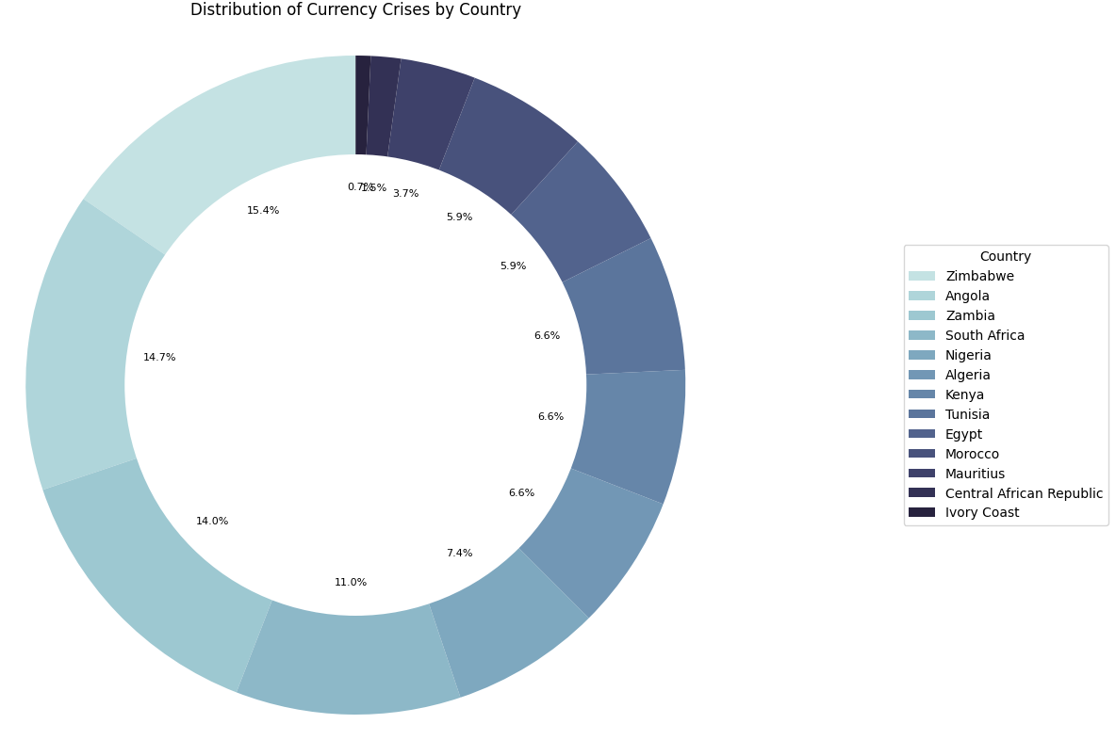
Donut Plot - Currency Crisis
Zimbabwe has the highest number of currency crises, constituting 15.4% of all currency crises in Africa.
Angola follows closely as the second-highest, representing 14.7% of all currency crises in the continent.

Slide 7
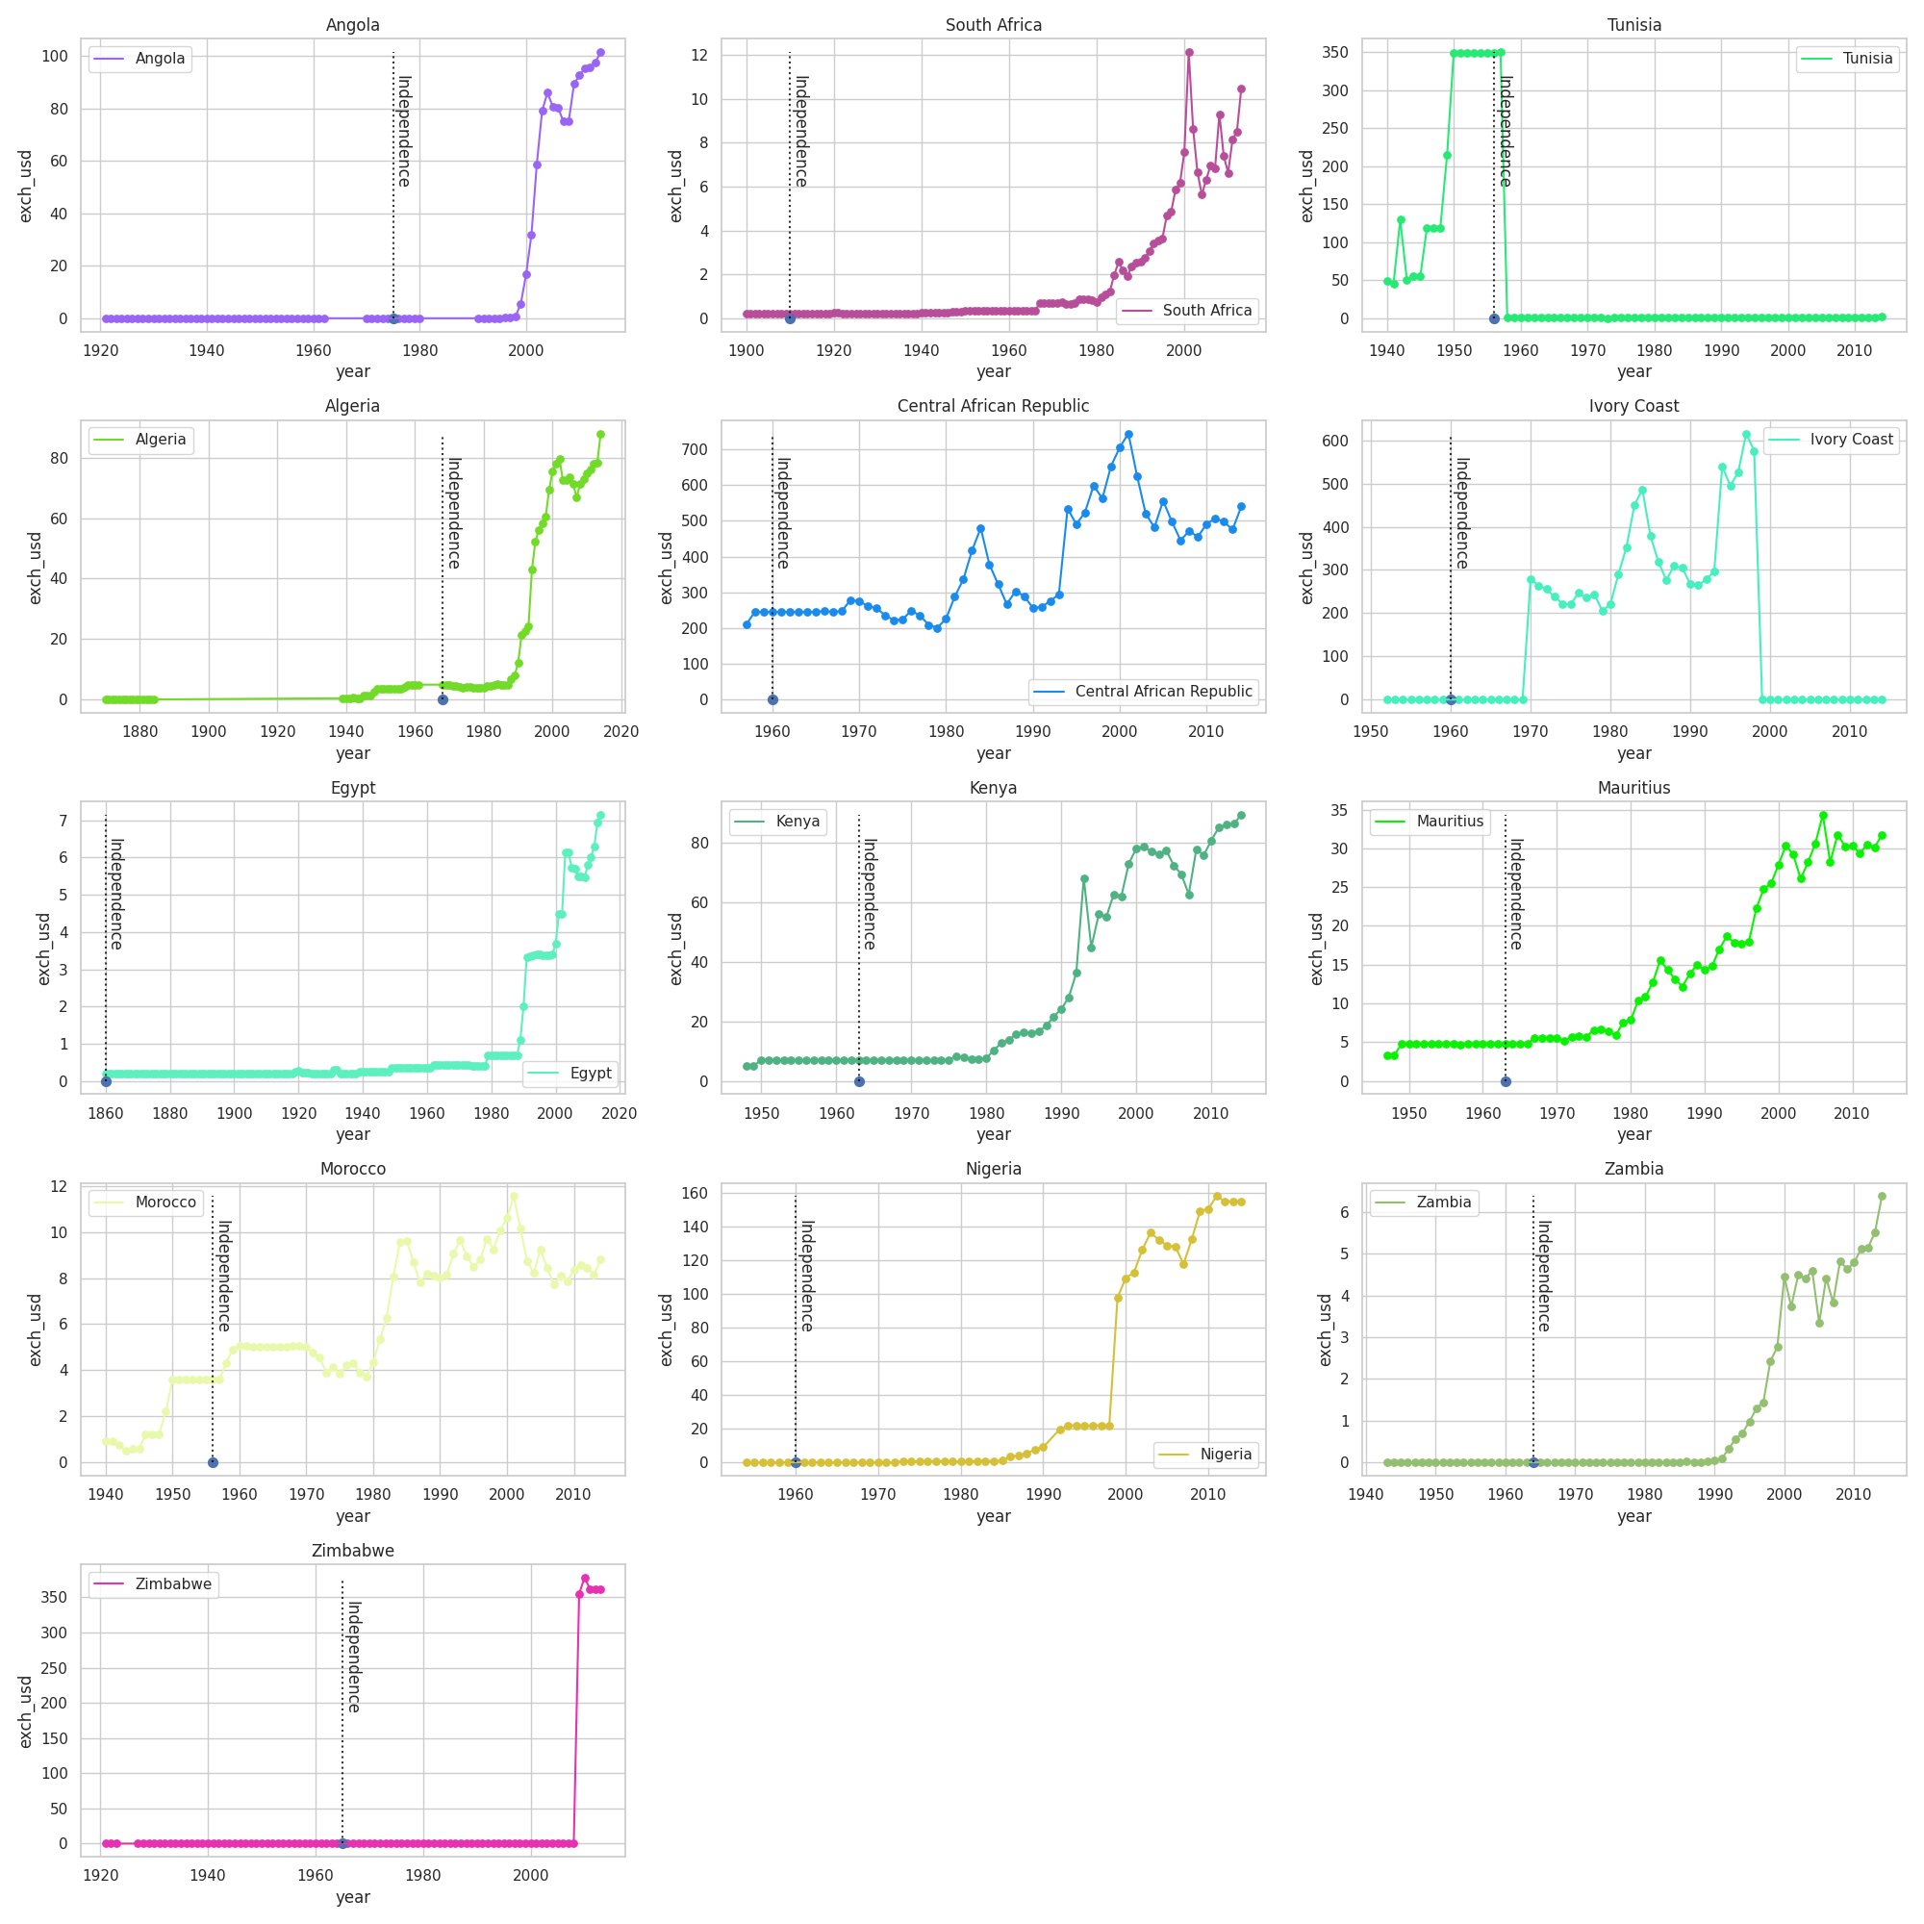
Time Series - Exchange Rate
Generally higher exchange rates in North African countries (e.g., Morocco, Algeria, Tunisia) compared to Sub-Saharan African countries (e.g., Nigeria, Zambia).

Slide 8
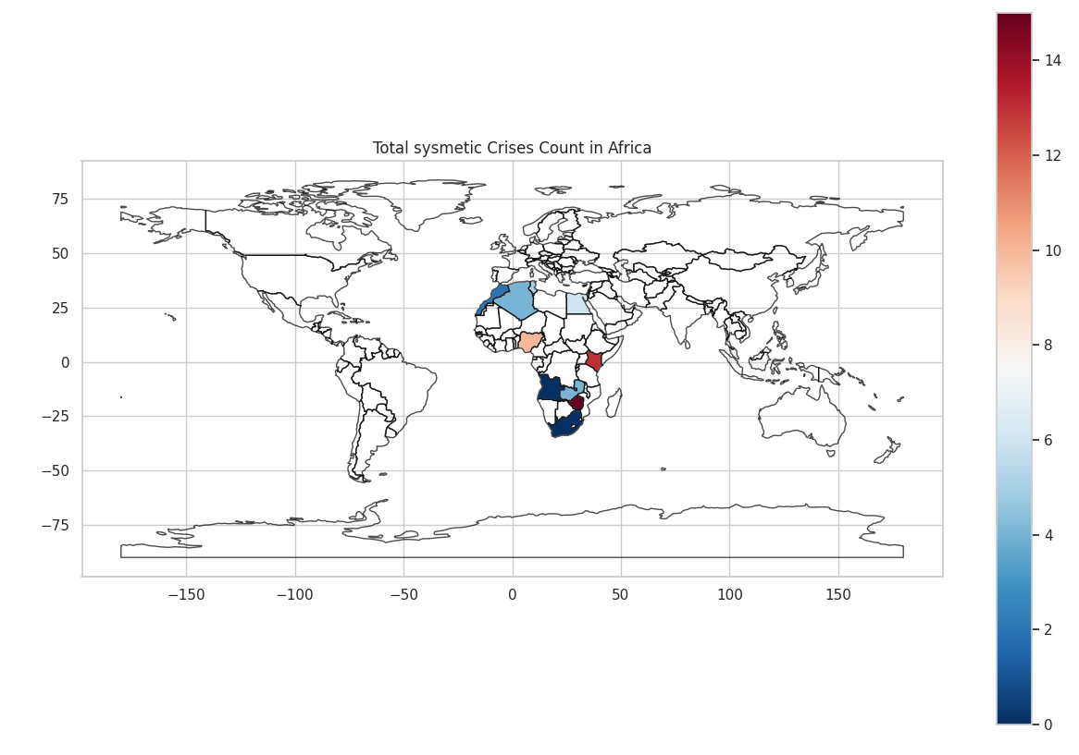
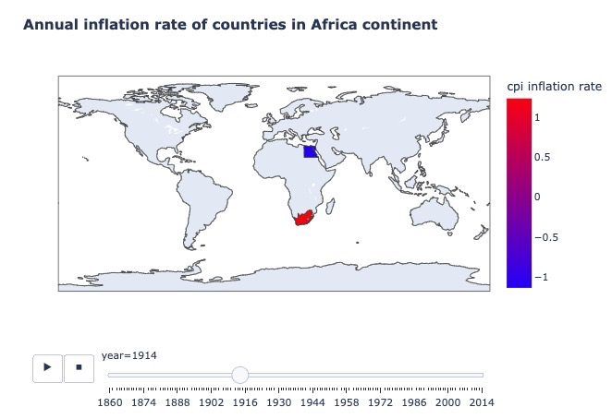
Map Visualizations - Systemic Crisis and Inflation Rate

Slide 9
Results and key findings
Over recent decades, systemic crises have become more frequent, with Central and West Africa experiencing a higher concentration than North and Southern Africa.
Central/West Africa sees systemic crises due to larger economies.
Inflation rises with weaker exchange rates, affecting imports.
Exchange rates vary widely, signaling currency crisis risks.
Economic scale, reliance on commodities, debt affect currency crises.
Africa's complex economy links inflation, exchange rates, crises.
Strategies needed: governance, diversification, visual aids.

Slide 10
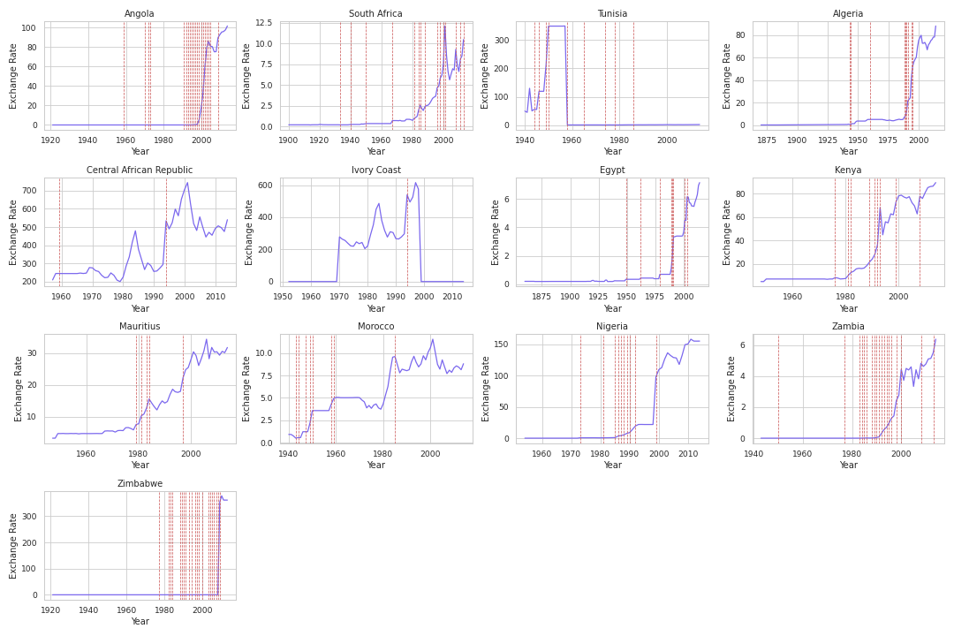
Relationship between Exchange Rates and Currency Crises
Stronger positive associations are observed in economically weaker countries with higher debts, while stronger negative ties are found in economically robust nations with lower debts.
This trend has inclined towards a more positive correlation in African countries, attributed to increased global economic integration and rising commodity prices.

Slide 11
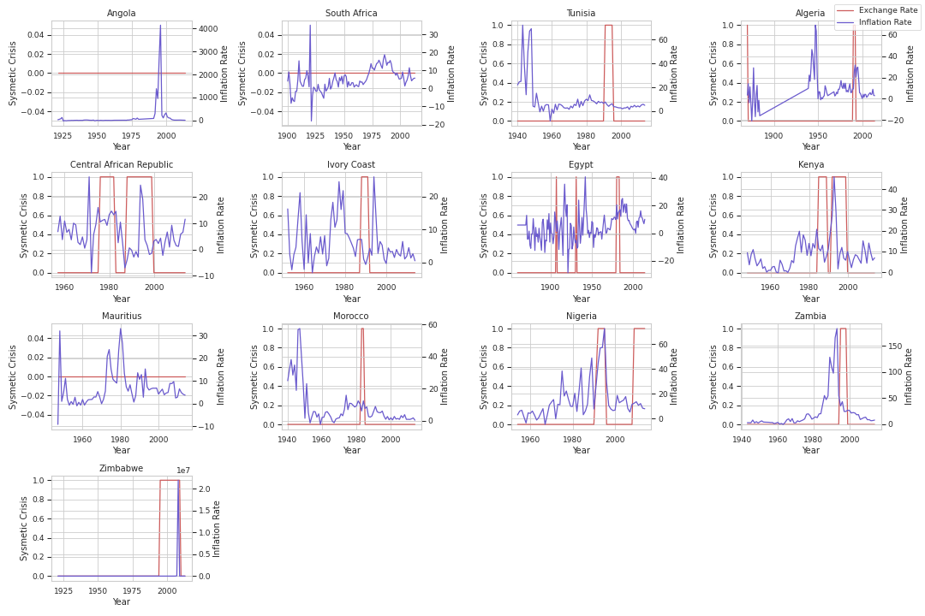
Relationship between Inflation Rates and Systemic Crises
Strong positive correlations often align with weaker economies and higher debt, while strong negative correlations associate with robust economies and lower debt.
Recent years have seen a shift towards a more positive relationship in African countries, attributed to factors like increased global economic integration and rising commodity prices.

Slide 12
Conclusion
African systemic crises disrupt economic stability, emphasizing the need for robust regulatory frameworks and proactive measures to mitigate their cascading effects.
Variations in inflation rates across African nations highlight the complexities of economic policy, urging targeted monetary policies to manage inflationary pressures.
Exchange rate fluctuations often precede currency crises, impacting broader economic stability, underscoring the necessity of stable rates for sustained growth.
Understanding these relationships aids in devising proactive strategies, emphasizing the importance of monitoring exchange rates for anticipating potential crises and fortifying economic resilience.

Slide 13
References
Daumont, Roland E. "Banking in Sub-Saharan Africa: What Went Wrong?" International Monetary Fund (2004). https://www.imf.org/external/pubs/ft/wp/2004/wp0455.pdf
Caprio, Gerard, and Daniela Klingebiel. "Banking Crises: A Survey." World Bank (2002).
Lindgren, Carl-Johan, et al. "Financial Sector Crisis and Restructuring: Lessons from Asia." International Monetary Fund (1996).
Xiong, Wei. "Banking Crises Without Panics." Princeton University (2008). Available at: https://wxiong.mycpanel.princeton.edu/papers/BankingCrisis.pdf
Inoue, Takeshi, and Shigeyuki Hamori. "Financial Access and Economic Growth: Evidence from Sub-Saharan Africa." Emerging Markets Finance and Trade 52 (2016): 743-753.
Jajah, Yussif Issaka, Ebenezer B. Anarfo, and Felix K. Aveh. "Financial Inclusion and Bank Profitability in Sub-Saharan Africa." International Journal of Finance & Economics 27 (2022): 32-44.
African Development Bank Group - Economic Research URL: https://www.afdb.org/en/knowledge/publications
World Bank - Africa Data https://data.worldbank.org/region/africa
International Monetary Fund (IMF) - Africa Region; https://www.imf.org/external/Pubs/CAT/region.aspx

Slide 14
Thank you

